Slide 1

RadioInstigator
Signals Intelligence Platform

Slide 2
Who am I?
Josh Conway (CrankyLinuxUser)
FCC Amateur radio: KC9JEF Facial Recog for your ‘Con (CPU bound, no gpu, no internet) https://hackaday.com/2015/03/04/face-recognition-for-your-next-con/ Multisite Home/Office/Hackerspace Automation
https://hackaday.io/project/12985-multisite-homeofficehackerspace-automation
Thalmic Labs(North) Shuts Down Free Developer Access Update: It’s Back Again https://hackaday.com/2014/11/18/thalmic-labs-shuts-down-free-developer-access/

Slide 3
What is this “Radio” thing, anyways?

Slide 4

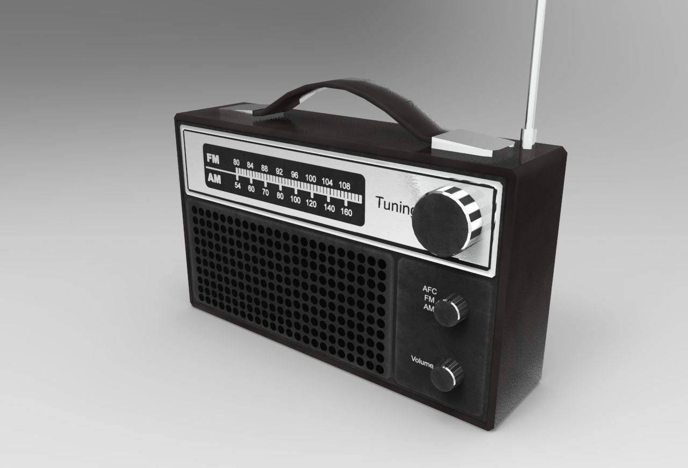

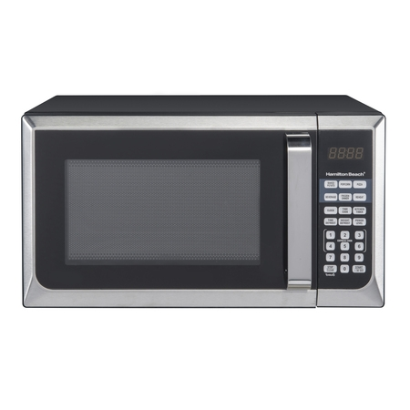


Is this a radio? Is that a radio???

Slide 5
They all are!
Definition (noun): The transmission and reception of electromagnetic waves of radio frequency, especially those carrying sound messages.
Definition (verb): communicate or send a message by radio.

Slide 6
Signals Intelligence
Signals intelligence (SIGINT) is intelligence-gathering by interception of signals, whether communications between people (communications intelligence—abbreviated to COMINT) or from electronic signals not directly used in communication (electronic intelligence—abbreviated to ELINT).
-- Wikipedia
BUT WHY DO WE CARE???

Slide 7




Common household things… Right?

Slide 8
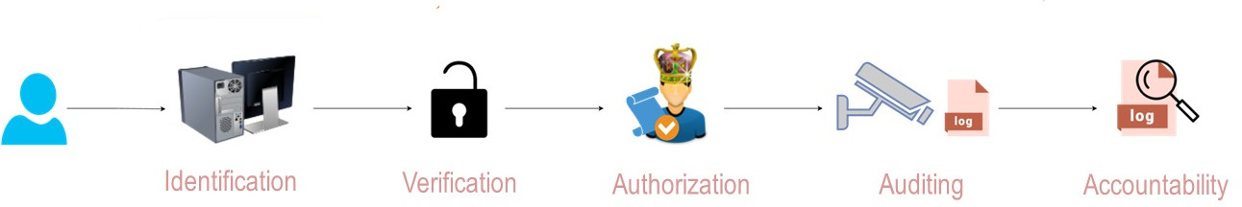
Security? Not if we can get away without it!
How many of these are implemented on radios you own?
Are they secure?
Are you sure???

Slide 9
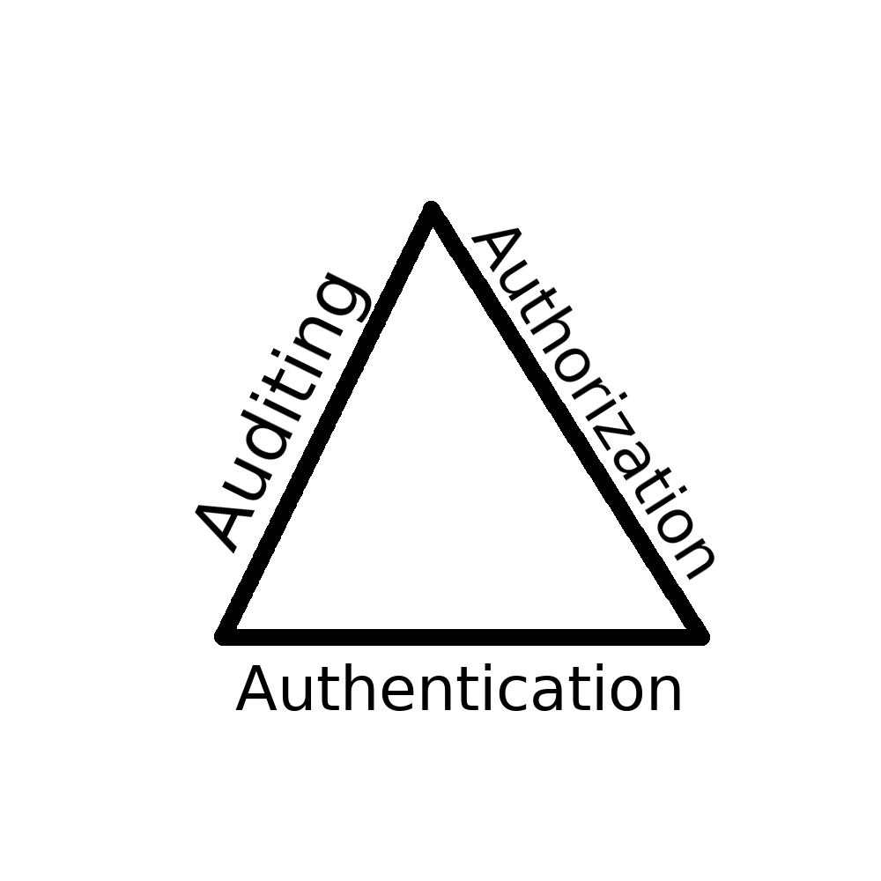



…. Don’t mind if I do!
Unknown
hardware
Unencrypted

Slide 10


We are watching you

Slide 11
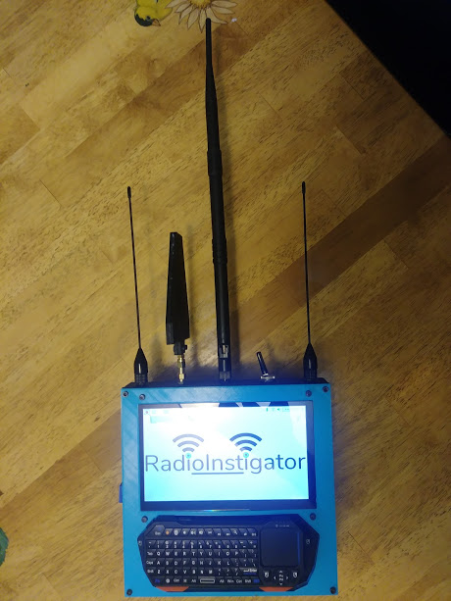
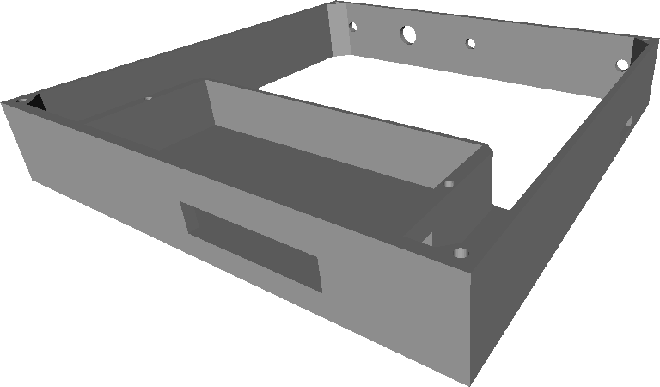
My Platform - A $150 Signals Intelligence Tablet
Raspberry Pi 3 B+
HDMI Touchscreen
RTL-SDR
Keyboard
Cool prints!

Slide 12

You want to build one?

Slide 13
SigInt on a shoestring or Dirty SigInt Deeds Done Dirt Cheap

Slide 14
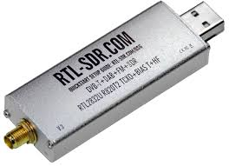
The Notorious RTL-SDR
GOOD | BAD
Cheap Easy to obtain 24MHz-1766MHz 2.4MHz Bandwidth (window) | Cheap Sometimes dubious build quality Janky included antennas

Slide 15
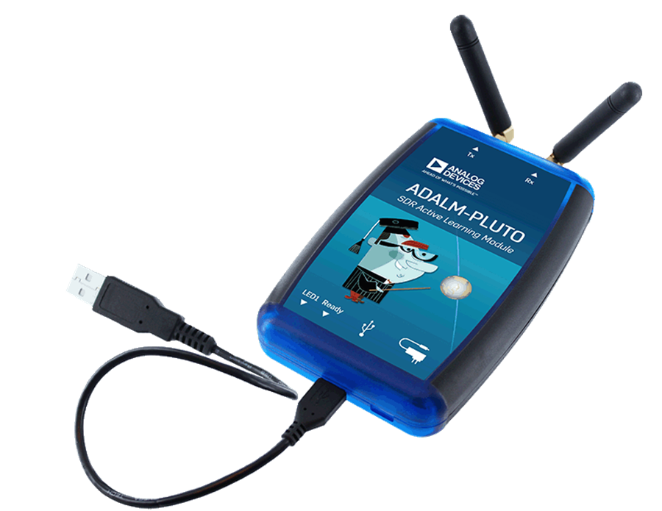
ADALM-PLUTO
GOOD | BAD
$100-$150 Uber-hackable (dual core Arm with Linux) 70MHz-6GHz (?!) 20MHz Bandwidth (window) Can run programs on device! | Can be hard to obtain 5mW Tx Janky included antennas USB2 limits overall bandwidth

Slide 16
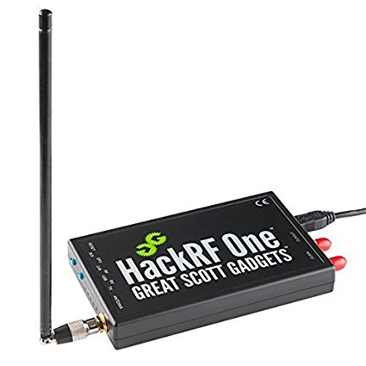
HackRF
GOOD | BAD
~$300 Very well supported 1MHz-6GHz (?!?!) Sweep Mode – 8GHz/second | Simplex (Can Tx or Rx, not at the same time) 8 bit IQ

Slide 17
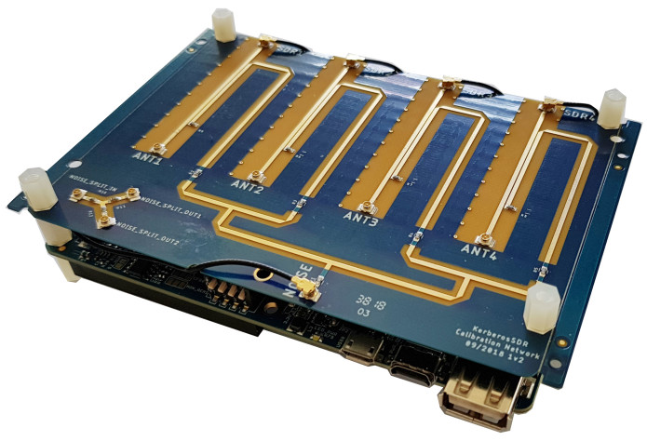
KerberosSDR
GOOD | BAD
~$125 Coherent Quad RTL-SDR 24MHz-1.7GHz | Toolchain very ‘raw’ because new 8 bit IQ

Slide 18
Antennas … Because the ones with the SDR suck

Slide 19
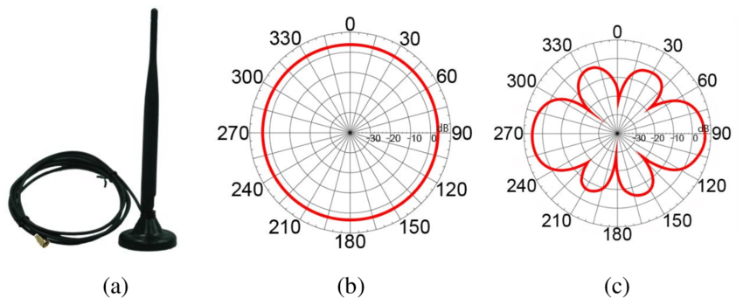
Omnidirectional Antennas
Horizontal
Polarization
Vertical
Polarization

Slide 20
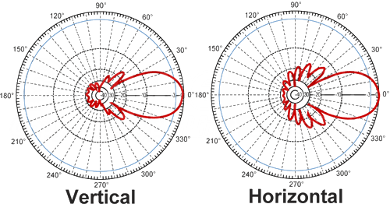
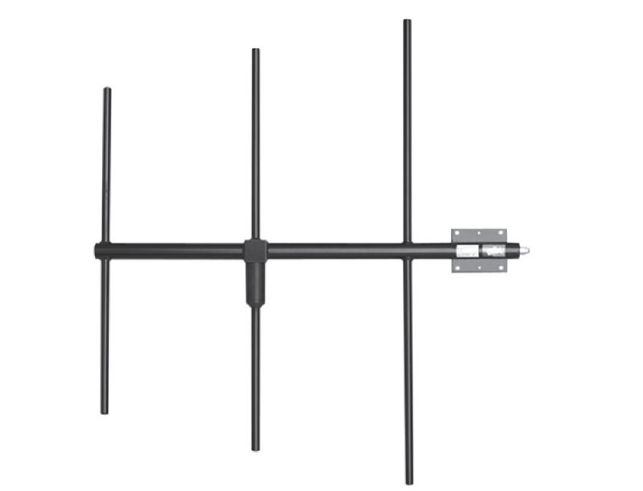
Yagi Antennas

Slide 21
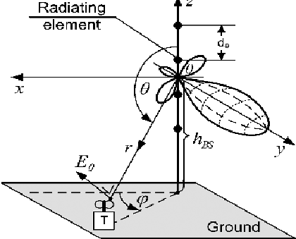
Yagi Antennas cont’d

Slide 22
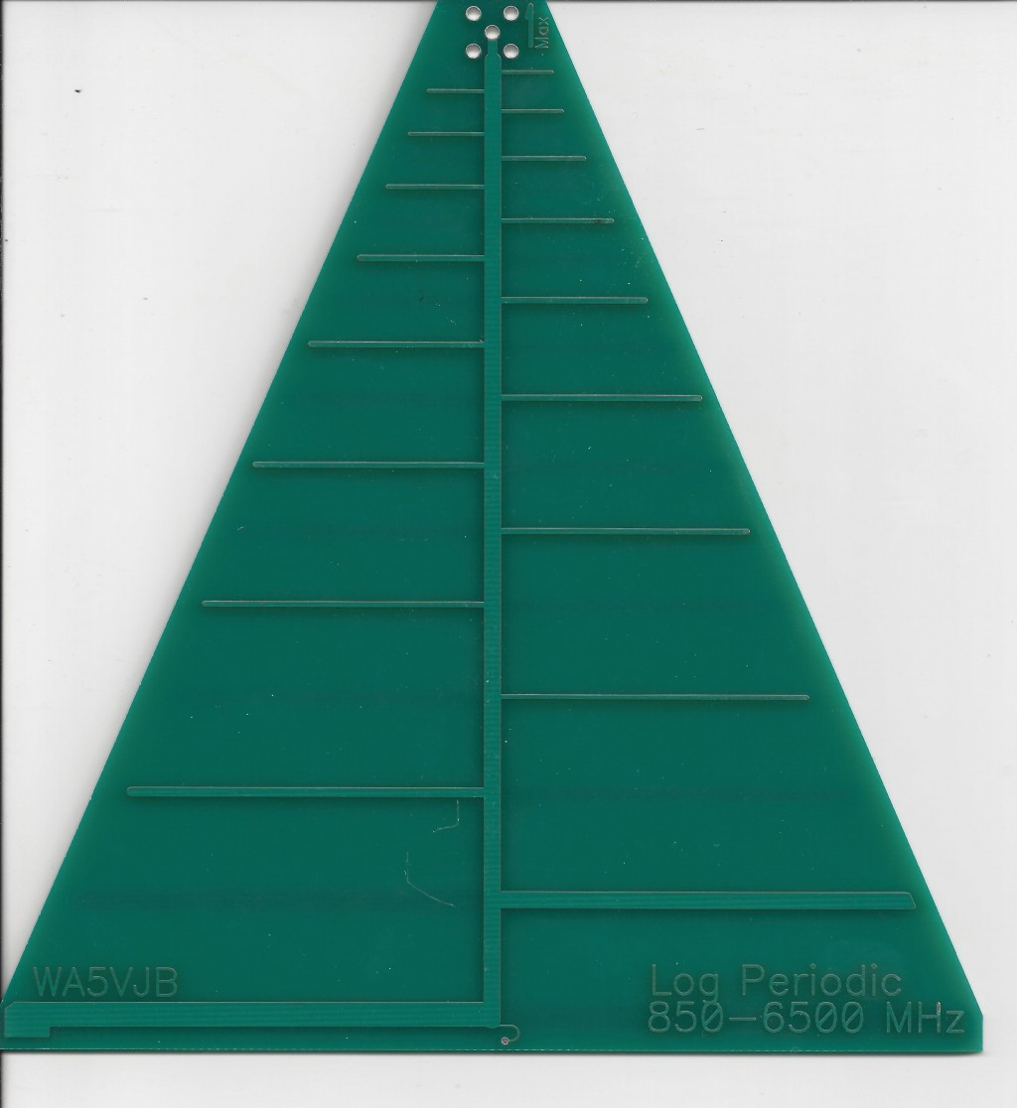
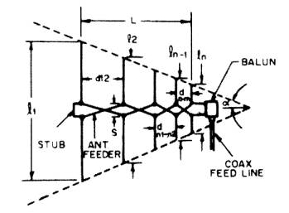
Log Parabolic Antennas

Slide 23
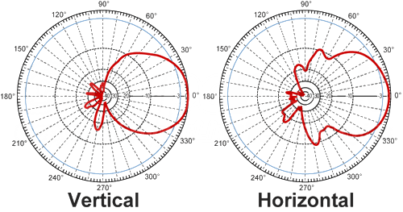
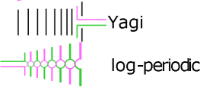
Log Parabolic Antennas

Slide 24


Vivaldi Antennas

Slide 25


Software Whisperer
(OS, Libraries)
RPITX Library RTL_SDR Libraries

Slide 26
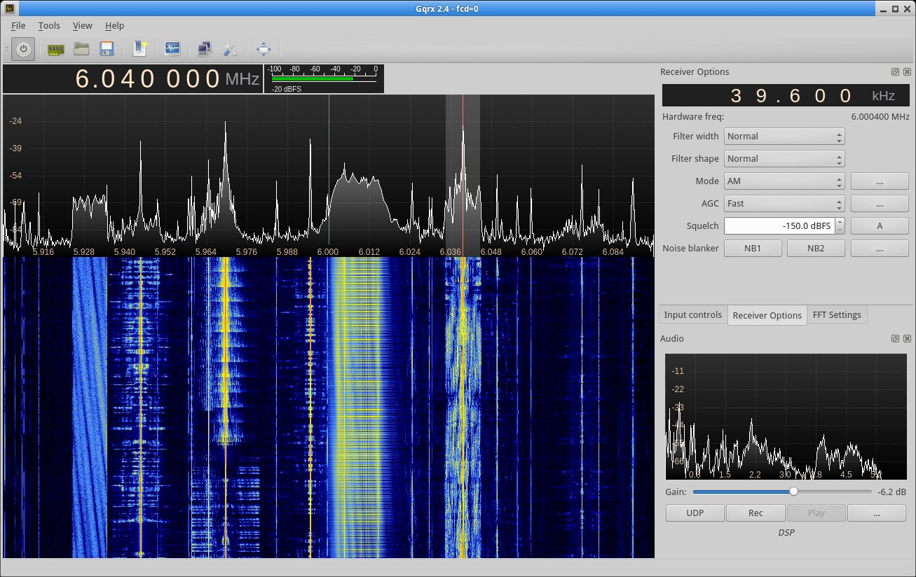
Software / GQRX

Slide 27
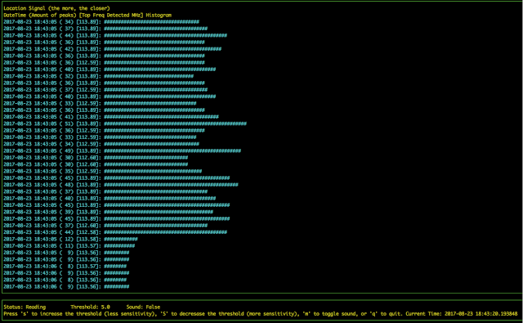
Salamandra - Spy Microphone Detector

Slide 28
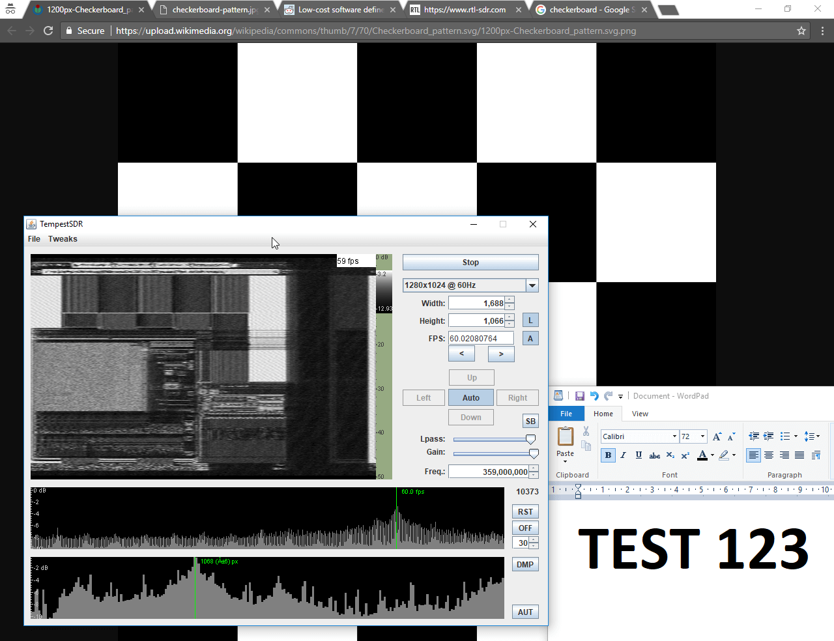
TempestSDR - Every Monitor is Wireless

Slide 29
Demotime….

Slide 30
You want to build one?

Slide 31
RadioInstigator
Signals Intelligence Platform
Josh Conway

